Slide 1
Higher Biology
Growth & Metabolism of Micro-organisms
Mr G R Davidson

Slide 2
Micro-organisms
Micro-organisms are organised into prokaryotes and eukaryotes.
Prokaryotes include bacteria and archaea (including thermophiles).
Eukaryotes include fungi (yeast), algae and protozoans.

Slide 3
Micro-organisms
Micro-organisms are able to make use of a huge range of substrates for metabolism and produce a huge range of products.
This means they can inhabit just about every possible environment there is.
Because of the huge variety of products they produce, micro-organisms can be used to make products useful to us.
Examples of this include bread, wine, etc. which are products of yeast.

Slide 4
Micro-organisms
More recently we have started to use micro-organisms on an industrial scale to produce a great many products.
We use micro-organisms for this because:
They reproduce very quickly.
They produce a huge variety of products.
They are easy to grow.

Slide 5
Control of Metabolism
Micro-organisms are useful because we can control their metabolism relatively easily.
By carefully controlling their growth medium and their environmental conditions, we can influence what is produced.

Slide 6
Control of Metabolism
There are many types of growth medium including:
Liquid media which we call broth.
Solid media which we call agar jelly.
These contain the essential nutrients which the micro-organisms will use in their metabolism.

Slide 7
Control of Metabolism
The environmental conditions in which the micro-organisms are grown also need to be very carefully controlled.
These include:
pH
Temperature
Oxygen concentration

Slide 8
Environmental Conditions
It is important, when preparing culture media, that aeseptic techniques are used.
This involves preventing contamination by keeping things sterile.

Slide 9
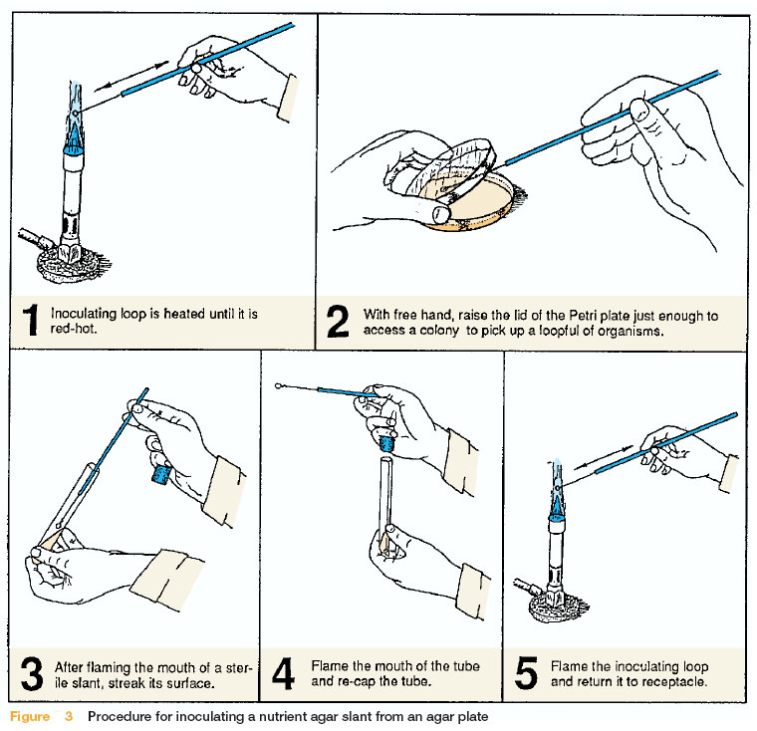
Aeseptic Techniques

Slide 10
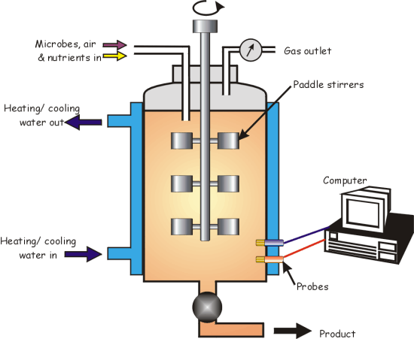
Fermenters

Slide 11
Fermenters
Fermenters or bioreactors are used to grow micro-organisms on a huge scale.
They are usually computer controlled to help keep environmental conditions as stable as possible.
The fermenter has sensors which can measure factors which need to be controlled and appropriate changes can be made in order to keep conditions at the optimum level.

Slide 12
Micro-organism Growth
Growth is the irreversible increase in dry biomass.
However, in microbes we measure growth by measuring the increase in cell numbers over a given period of time.
This results in a four phase growth pattern.

Slide 13
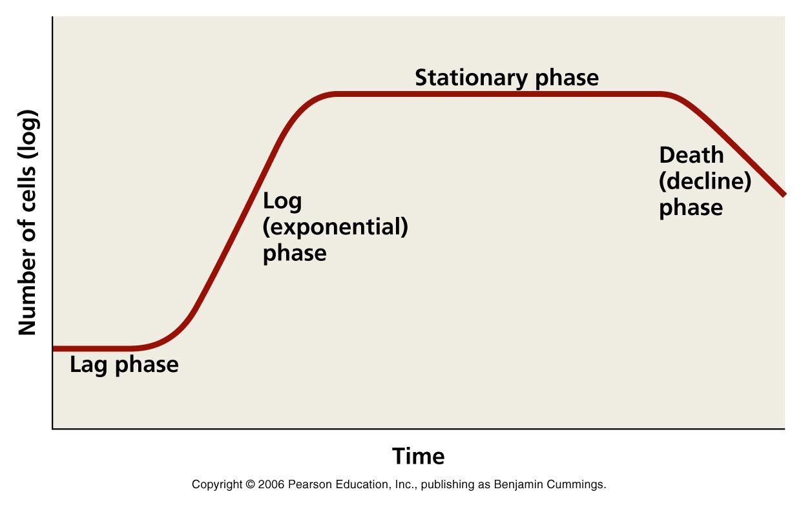
Micro-organism Growth

Slide 14
Micro-organism Growth
The lag phase shows very little increase in cell number as the cells adjust to the conditions.
At this stage there is an increase in metabolic activity as they induce new enzymes to metabolise the substrate.
At this stage there is no cell division.

Slide 15
Micro-organism Growth
The log phase (exponential phase) is when the cells grow and multiply as fast as they can.
This is very much dependant on the culture medium and the environmental factors.

Slide 16
Linear Scales
Number of Bacteria
0
1
2
3
4
5
6
7
8
9
10
11
12
Time (hours)

Slide 17
Micro-organism Growth
Because of the rapid increase in cell numbers in this stage, it is often difficult to represent this on normal graph paper with normal scales.
The best way to solve this is to use a log scale where the scale increases exponentially at each interval on the y-axis.

Slide 18
Log Scale
Number of Bacteria
0
1
2
3
4
5
6
7
8
9
10
11
12
Time (hours)

Slide 19
Micro-organism Growth
The stationary phase takes place as the nutrients begin to run out or toxic products begin to accumulate.
At this point the number of cells dying is equal to the number of new cells being produced.

Slide 20
Micro-organism Growth
The final phase is the death phase when the number of cells dying exceeds the number of new cells being produced.
At this point there is a lack of substrate to support new cells or the products are so toxic that they can no longer survive.

Slide 21
Controlling Metabolism
Some microbes show two forms of metabolism.
Primary metabolism happens during the first 2 phases of growth (lag and log phases).
The organism is producing primary metabolites which are needed for growth, e.g. amino acids.

Slide 22
Controlling Metabolism
Secondary metabolism happens in the last 2 stages of growth (stationary and death phases).
It produces secondary metabolites which are not required for growth.

Slide 23
Controlling Metabolism
They may be used to gain an advantage, e.g. producing antibiotics which will inhibit or kill other microbes competing for the same resources.
Some of these secondary metabolites can be useful to humans, and so these microbes are harvested on an industrial scale to mass produce the product.

Slide 24
Controlling Metabolism
Micro-organisms can control their metabolic regulation by inducing or inhibiting enzymes, and by inhibiting the end product.
When metabolites are being produced on an industrial scale extra precursors, inducers or inhibitors may need to be added to ensure the correct substance is produced.

Slide 25
Controlling Metabolism
The precursor is acted on by an enzyme to produce a continuous supply of the next metabolite.
The inducer is the next metabolite which causes a specific enzyme to be made, and this will then produce the desired substance.

Slide 26
Controlling Metabolism
Inhibitor
Enzyme P
Enzyme Q
Enzyme R
Substance 1
Substance 2
Substance 3
Substance 4
Precursor
Inducer
Final product
Final product

Slide 27
Controlling Metabolism
In this example Substance 1 acts as the precursor and will be acted upon by enzyme P to produce a steady supply of substance 2.
Substance 2 acts as the inducer because it induces the supply of enzyme Q which is needed to produce the final product, substance 3.

Slide 28
Controlling Metabolism
Substance 3 would normally be acted on by enzyme R to produce substance 4, but in this case we add an inhibitor, which inhibits enzyme R, to prevent this from happening.
This allows substance 3 to be the final product which is what we require.

